Slide 1
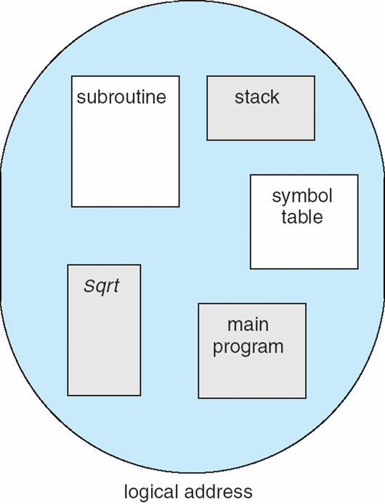
Segmentation
Memory-management scheme that supports user view of memory
A program is a collection of segments
A segment is a logical unit such as:
main program
procedure
function
method
object
local variables, global variables
common block
stack
symbol table
arrays

Slide 2
Logical View of Segmentation
1
1
4
2
3
4
2
3
user space
physical memory space

Slide 3
Segmentation Architecture
Logical address consists of a two tuple:
<segment-number, offset>,
Segment table – maps two-dimensional physical addresses; each table entry has:
base – contains the starting physical address where the segments reside in memory
limit – specifies the length of the segment
Segment-table base register (STBR) points to the segment table’s location in memory
Segment-table length register (STLR) indicates number of segments used by a program;
segment number s is legal if s < STLR

Slide 4
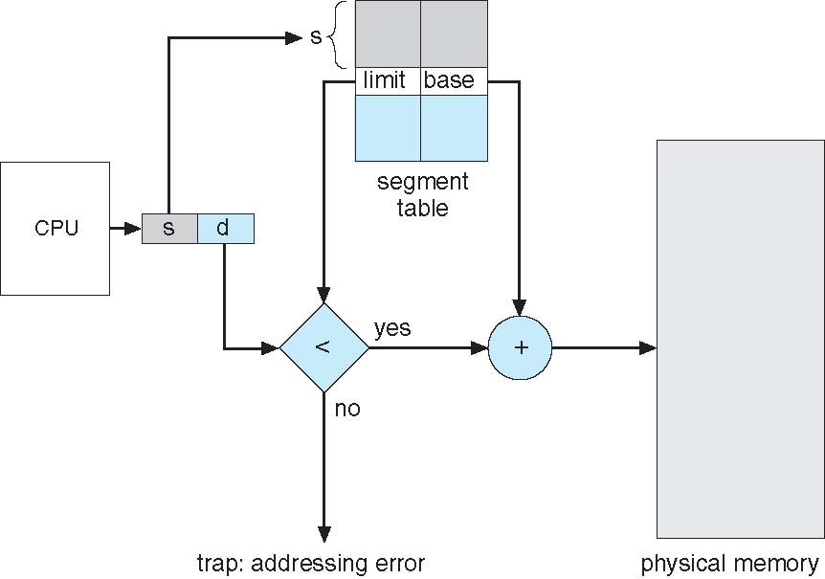

Slide 5
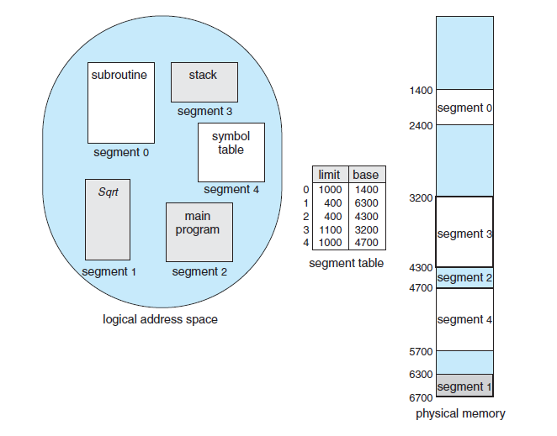

Slide 6
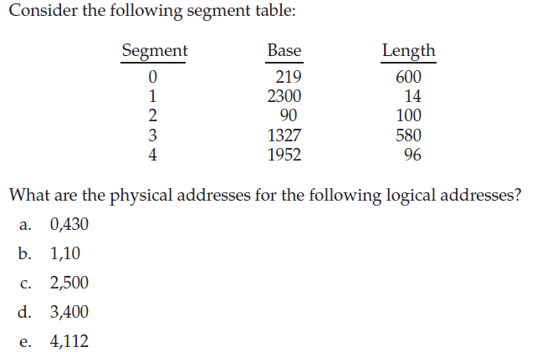

Slide 7
(a) 219 + 430 = 649
(b) 2300 + 10 = 2310
(c) illegal reference; traps to operating system
(d) 1327 + 400 = 1727
(e) illegal reference; traps to operating system

Slide 8
Q. The logical address space in a computer system consists of 128 segments each segment can have up to 32 pages of 4K words In each. Physical memory
consists of 4K block of 4K words In each. Formulate the logical and physical address formats.

Slide 9
In a paged-segmented system , a virtual address consists of 32 bits of which 12 bits are
displacement ,11 bits segment number and 9 bits are page numbers. Calculate the following:
Page size
Max segment size
Max number of Pages
Max number of segments

Slide 10
A Computer provides each process with 65536 bytes of address space divided into pages of 4096 bytes. A particular program has instruction of 32768 bytes , a data size of 16386 bytes and a stack size of 15870 bytes. Will this program fit in the address space? If the page size were 512 bytes , would it fit? Remember that a page may not contain part of two different segments.

Slide 11
Thanks

